Slide 1
Computer Vision and Deep Learning
Lecture 3

Slide 2
Last time – linear classification
Score function: to map inputs (images) to class scores
Loss function: to evaluate a classifier
Hinge loss
Softmax loss
Optimization: gradient descent
Numerical gradient
Analytical gradient

Slide 3
Today’s agenda
Evaluating a model’s performance
Computational graphs
Backpropagation
Artificial neural networks
Activation functions
Image convolutions (one step forward towards convolutional neural networks)

Slide 4
Evaluating a model’s performance

Slide 5
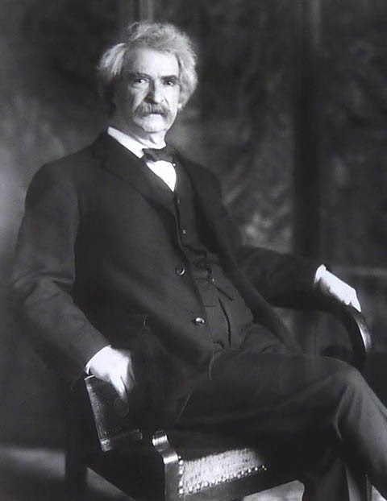
"Facts are stubborn things, but statistics are more pliable. " – Mark Twain
"There are three kinds of lies: lies, damned lies, and statistics. " – popularized by Mark Twain
Mark Twain

Slide 6
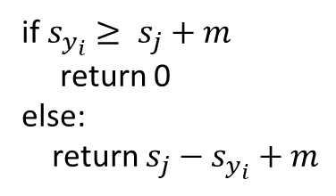
Evaluation metrics
True positives (TP)
False positives (FP)
True negatives (TN)
False negatives (FN)
Accuracy: The percent of predictions that the model got right
$$ACC=\frac{TP+TN}{TP+TN+FP+FN}$$

Slide 7
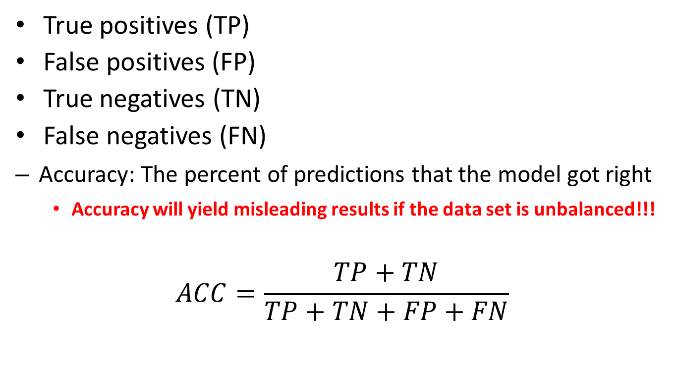
Evaluation metrics
True positives (TP)
False positives (FP)
True negatives (TN)
False negatives (FN)
Accuracy: The percent of predictions that the model got right
Accuracy will yield misleading results if the data set is unbalanced!!!
$$ACC=\frac{TP+TN}{TP+TN+FP+FN}$$

Slide 8
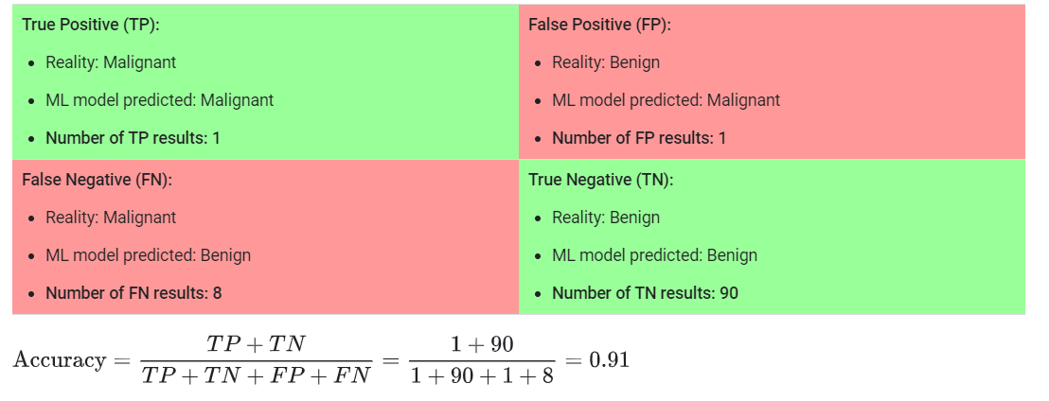
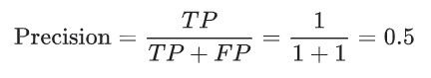
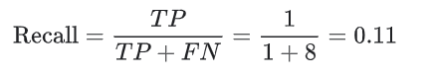
Tumour classification

Slide 9
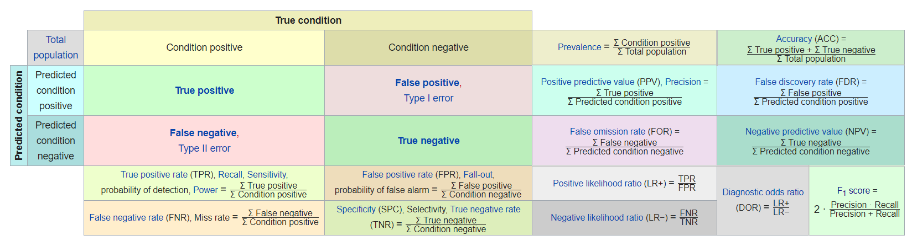
Confusion matrix
Image source: https://en.wikipedia.org/wiki/Confusion_matrix

Slide 10
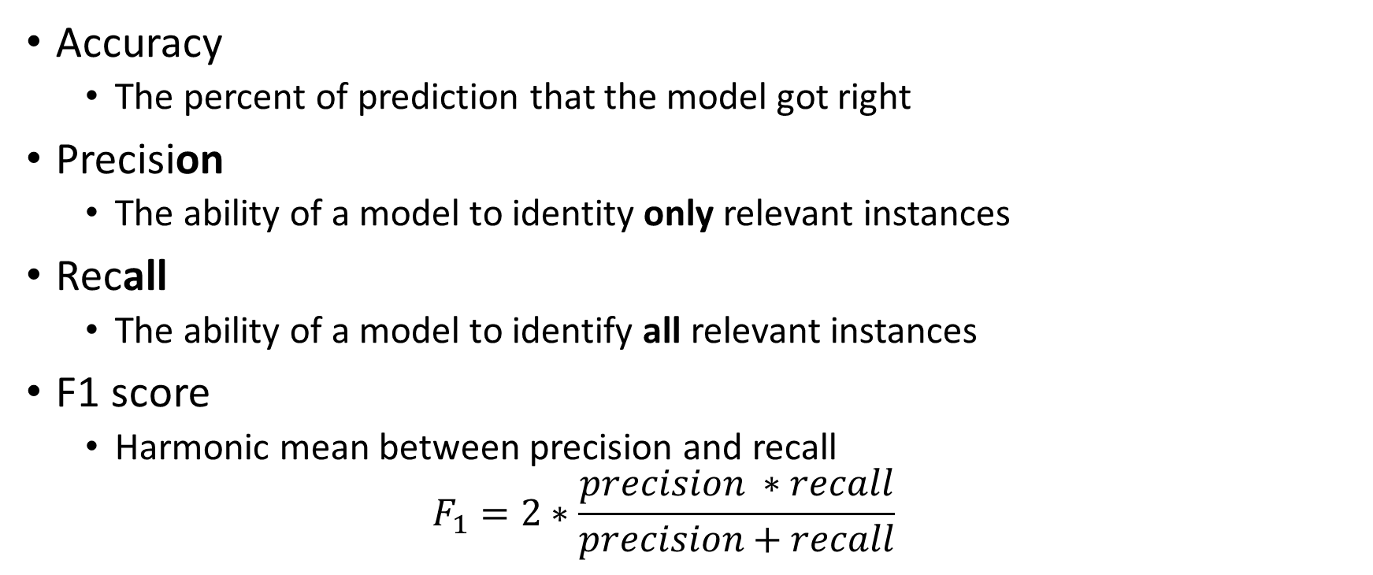
Precision, Recall, F1 score
Accuracy
The percent of prediction that the model got right
Precision
The ability of a model to identity only relevant instances
Recall
The ability of a model to identify all relevant instances
F1 score
Harmonic mean between precision and recall
$$F_{1}=2∗\frac{precision ∗recall}{precision+recall}$$

Slide 11
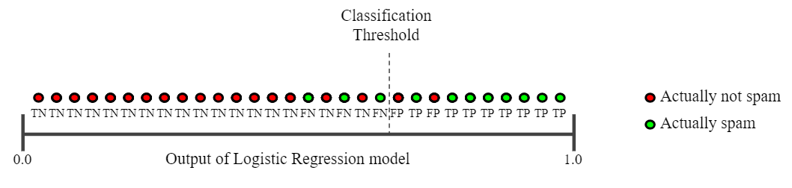
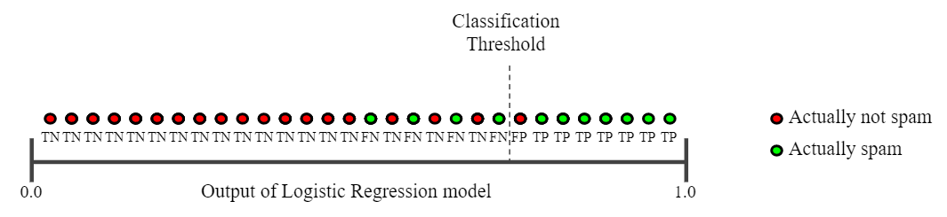
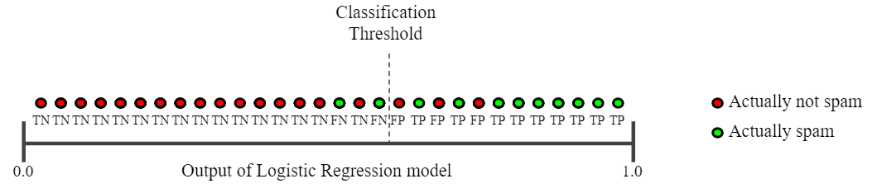
Precision vs. recall
Precision: 0.8
Recall: 0.73
Precision: 0.88
Recall: 0.64
Precision: 0.75
Recall: 0.82
https://developers.google.com/machine-learning/crash-course/classification/precision-and-recall

Slide 12
Precision vs. recall
Precision: spam detection, predict when to launch a satellite, pregnancy tests etc.
Recall: airport security (make sure that every suspicions event is investigated), cancer prediction, detecting credit card frauds etc.

Slide 13
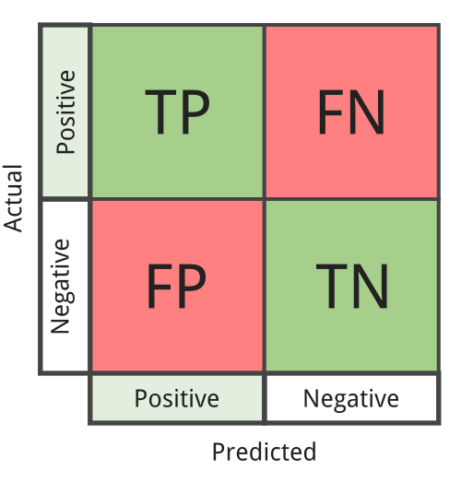
Receiver Operating characteristic curve ROC curve
Shows the performance of a classifier at different classification thresholds
False Positive Rate (1- specificity) – x axis
True Positive Rate (sensitivity) – y axis
TPR
FPR

Slide 14
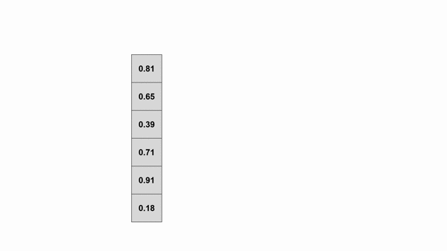
Receiver Operating characteristic curve ROC curve
https://towardsdatascience.com/roc-curve-and-auc-from-scratch-in-numpy-visualized-2612bb9459ab

Slide 15
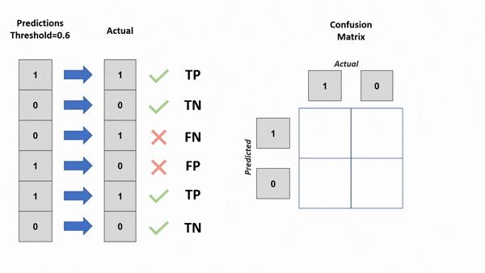
Receiver Operating characteristic curve ROC curve
https://towardsdatascience.com/roc-curve-and-auc-from-scratch-in-numpy-visualized-2612bb9459ab

Slide 16
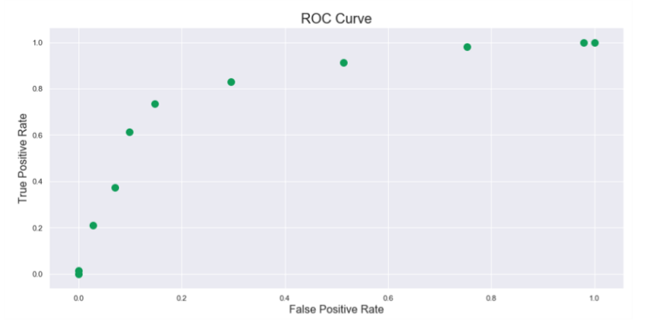
Receiver Operating characteristic curve ROC curve
https://towardsdatascience.com/roc-curve-and-auc-from-scratch-in-numpy-visualized-2612bb9459ab

Slide 17
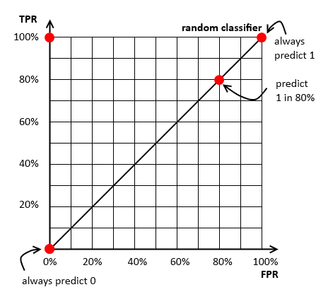
Receiver Operating characteristic curve ROC curve
Shows the performance of a classifier at different classification thresholds

Slide 18
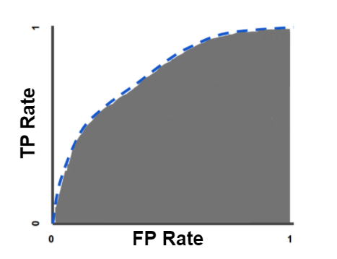
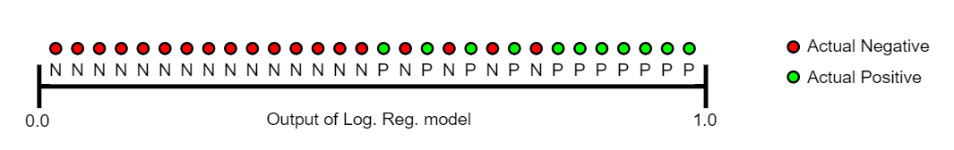
Area under the curve AUC
Measures the entire two-dimensional area underneath the entire ROC curve
Makes it easier to compare one ROC curve to another one

Slide 19

How do we compute the gradients?
Numerical gradient
Analytical gradient
Better idea: use computational graphs and back-propagation

Slide 20
Computational graphs
f(a, b, c) = a*b + c
a
*
b
+
f
c

Slide 21
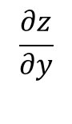
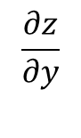
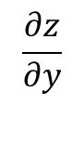
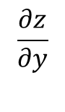
Back propagation
x
f
$$\frac{∂z}{∂y}$$
z
$$\frac{∂z}{∂y}$$
y
$$\frac{∂z}{∂y}$$
$$\frac{∂z}{∂y}$$
Local gradients
Influence of x and y on the nodes output z

Slide 22
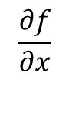
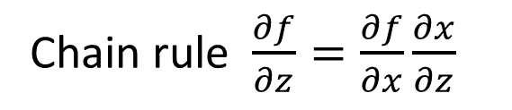
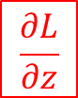
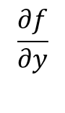
Back propagation
x
Chain rule $\frac{∂f}{∂z}=\frac{∂f}{∂x}\frac{∂x}{∂z}$
f
$$\frac{∂f}{∂x}$$
z
$$\frac{∂f}{∂y}$$
$$\frac{∂L}{∂z}$$
Influence of z to the final output of the graph (loss)
y

Slide 23
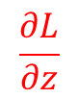
Back propagation
x
f
$$\frac{∂f}{∂x}$$
z
$$\frac{∂f}{∂y}$$
$$\frac{∂L}{∂z}$$
Influence of z to the final output of the graph (loss)
y

Slide 24
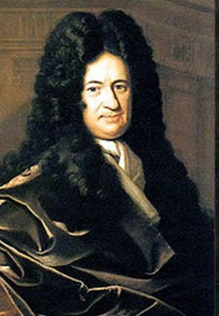

Back propagation
Chain rule $\frac{∂f}{∂z}=\frac{∂f}{∂x}\frac{∂x}{∂z}$
x
f
$$\frac{∂f}{∂x}$$
z
$$\frac{∂f}{∂y}$$
$$\frac{∂L}{∂z}$$
Influence of z to the final output of the graph (loss)
y

Slide 25
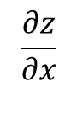
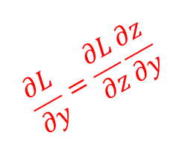
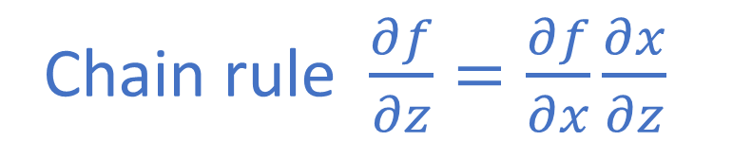
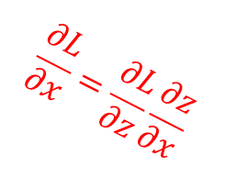
Back propagation
Chain rule $\frac{∂f}{∂z}=\frac{∂f}{∂x}\frac{∂x}{∂z}$
x
$$\frac{∂L}{∂x}=\frac{∂L}{∂z}\frac{∂z}{∂x}$$
f
$$\frac{∂z}{∂x}$$
z
$$\frac{∂z}{∂y}$$
$$\frac{∂L}{∂z}$$
$$\frac{∂L}{∂y}=\frac{∂L}{∂z}\frac{∂z}{∂y}$$
Influence of z to the final output of the graph (loss)
y

Slide 26
Back propagation
Use a recursive application of the chain rule on every node in the graph to computer influence of all the intermediate nodes on the output of the graph

Slide 27
Computational graphs – forward pass
f(a, b, c) = a*b + c
3
a = 3
b = 2
c = -4
a
*
12
4
b
+
f
8
-4
c

Slide 28
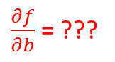
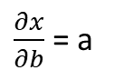
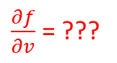
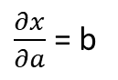
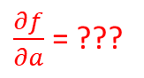
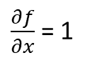
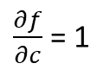
Computational graphs – backward pass
Go backward, from the end of the computational graph, and compute the gradient for each node in the graph
3
f(a, b, c) = a*b + c
a
$\frac{∂x}{∂a}$ = b
*
x
x = a*b
12
$\frac{∂x}{∂b}$ = a
4
b
+
f
8
$\frac{∂f}{∂c}$ = 1
f = x + c
$\frac{∂f}{∂x}$ = 1
-4
c
$\frac{∂f}{∂a}$ = ???
$\frac{∂f}{∂b}$ = ???
$\frac{∂f}{∂v}$ = ???

Slide 29
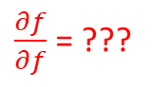
Computational graphs – backward pass
Go backward, from the end of the computational graph, and compute the gradient for each node in the graph
3
f(a, b, c) = a*b + c
a
$\frac{∂x}{∂a}$ = b
*
x
x = a*b
12
$\frac{∂x}{∂b}$ = a
4
b
+
f
8
$\frac{∂f}{∂c}$ = 1
$\frac{∂f}{∂f}$ = ???
f = x + c
$\frac{∂f}{∂x}$ = 1
-4
c
$\frac{∂f}{∂a}$ = ???
$\frac{∂f}{∂b}$ = ???
$\frac{∂f}{∂v}$ = ???

Slide 30
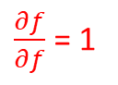
Computational graphs – backward pass
Go backward, from the end of the computational graph, and compute the gradient for each node in the graph
3
f(a, b, c) = a*b + c
a
$\frac{∂x}{∂a}$ = b
*
x
x = a*b
12
$\frac{∂x}{∂b}$ = a
4
b
+
f
8
$\frac{∂f}{∂c}$ = 1
$\frac{∂f}{∂f}$ = 1
f = x + c
$\frac{∂f}{∂x}$ = 1
-4
c
$\frac{∂f}{∂a}$ = ???
$\frac{∂f}{∂b}$ = ???
$\frac{∂f}{∂v}$ = ???

Slide 31
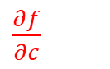
Computational graphs – backward pass
Go backward, from the end of the computational graph, and compute the gradient for each node in the graph
3
f(a, b, c) = a*b + c
a
$\frac{∂x}{∂a}$ = b
*
x
x = a*b
12
$\frac{∂x}{∂b}$ = a
4
b
+
f
8
$\frac{∂f}{∂c}$ = 1
1
f = x + c
$\frac{∂f}{∂x}$ = 1
-4
c
$\frac{∂f}{∂c}$
$\frac{∂f}{∂a}$ = ???
$\frac{∂f}{∂b}$ = ???
$\frac{∂f}{∂v}$ = ???

Slide 32
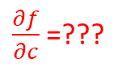
Computational graphs – backward pass
Go backward, from the end of the computational graph, and compute the gradient for each node in the graph
3
f(a, b, c) = a*b + c
a
$\frac{∂x}{∂a}$ = b
*
x
x = a*b
12
$\frac{∂x}{∂b}$ = a
4
b
+
f
8
$\frac{∂f}{∂c}$ = 1
1
f = x + c
$\frac{∂f}{∂x}$ = 1
-4
c
$\frac{∂f}{∂c}$=???
$\frac{∂f}{∂a}$ = ???
$\frac{∂f}{∂b}$ = ???
$\frac{∂f}{∂v}$ = ???

Slide 33
Computational graphs – backward pass
Go backward, from the end of the computational graph, and compute the gradient for each node in the graph
3
f(a, b, c) = a*b + c
a
$\frac{∂x}{∂a}$ = b
*
x
x = a*b
12
$\frac{∂x}{∂b}$ = a
4
b
+
f
8
$\frac{∂f}{∂c}$ = 1
1
f = x + c
$\frac{∂f}{∂x}$ = 1
-4
c
1
$\frac{∂f}{∂a}$ = ???
$\frac{∂f}{∂b}$ = ???
$\frac{∂f}{∂v}$ = ???

Slide 34
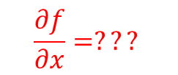
Computational graphs – backward pass
Go backward, from the end of the computational graph, and compute the gradient for each node in the graph
3
f(a, b, c) = a*b + c
a
$\frac{∂x}{∂a}$ = b
*
x
x = a*b
12
$\frac{∂x}{∂b}$ = a
4
b
$$\frac{∂f}{∂x}=???$$
+
f
8
$\frac{∂f}{∂c}$ = 1
1
f = x + c
$\frac{∂f}{∂x}$ = 1
-4
c
1
$\frac{∂f}{∂a}$ = ???
$\frac{∂f}{∂b}$ = ???
$\frac{∂f}{∂v}$ = ???

Slide 35
Computational graphs – backward pass
Go backward, from the end of the computational graph, and compute the gradient for each node in the graph
3
f(a, b, c) = a*b + c
a
$\frac{∂x}{∂a}$ = b
*
x
x = a*b
12
$\frac{∂x}{∂b}$ = a
4
b
$$\frac{∂f}{∂x}=???$$
+
f
8
$\frac{∂f}{∂c}$ = 1
1
f = x + c
$\frac{∂f}{∂x}$ = 1
-4
c
1
$\frac{∂f}{∂a}$ = ???
$\frac{∂f}{∂b}$ = ???
$\frac{∂f}{∂v}$ = ???

Slide 36
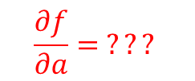
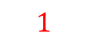
Computational graphs – backward pass
Go backward, from the end of the computational graph, and compute the gradient for each node in the graph
3
f(a, b, c) = a*b + c
a
$\frac{∂x}{∂a}$ = b
$$\frac{∂f}{∂a}= ???$$
*
x = a*b
x
12
$\frac{∂x}{∂b}$ = a
4
$$1$$
b
+
f
8
$\frac{∂f}{∂c}$ = 1
1
f = x + c
$\frac{∂f}{∂x}$ = 1
-4
c
1
$\frac{∂f}{∂a}$ = ???
$\frac{∂f}{∂b}$ = ???
$\frac{∂f}{∂v}$ = ???

Slide 37
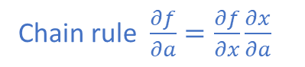
Computational graphs – backward pass
Go backward, from the end of the computational graph, and compute the gradient for each node in the graph
3
Chain rule $\frac{∂f}{∂a}=\frac{∂f}{∂x}\frac{∂x}{∂a}$
f(a, b, c) = a*b + c
a
$\frac{∂x}{∂a}$ = b
$$\frac{∂f}{∂a}= ???$$
*
x = a*b
x
12
$\frac{∂x}{∂b}$ = a
4
$$1$$
b
+
f
8
$\frac{∂f}{∂c}$ = 1
1
f = x + c
$\frac{∂f}{∂x}$ = 1
-4
c
1
$\frac{∂f}{∂a}$ = ???
$\frac{∂f}{∂b}$ = ???
$\frac{∂f}{∂v}$ = ???

Slide 38
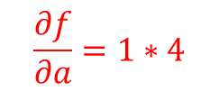
Computational graphs – backward pass
Go backward, from the end of the computational graph, and compute the gradient for each node in the graph
3
Chain rule $\frac{∂f}{∂a}=\frac{∂f}{∂x}\frac{∂x}{∂a}$
f(a, b, c) = a*b + c
a
$\frac{∂x}{∂a}$ = b
$$\frac{∂f}{∂a}=1∗4$$
*
x = a*b
x
12
$\frac{∂x}{∂b}$ = a
4
$$1$$
b
+
f
8
$\frac{∂f}{∂c}$ = 1
1
f = x + c
$\frac{∂f}{∂x}$ = 1
-4
c
1
$\frac{∂f}{∂a}$ = ???
$\frac{∂f}{∂b}$ = ???
$\frac{∂f}{∂v}$ = ???

Slide 39
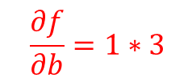
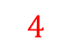
Computational graphs – backward pass
Go backward, from the end of the computational graph, and compute the gradient for each node in the graph
3
Chain rule $\frac{∂f}{∂a}=\frac{∂f}{∂x}\frac{∂x}{∂a}$
f(a, b, c) = a*b + c
a
$\frac{∂x}{∂a}$ = b
$$4$$
*
x = a*b
x
12
$\frac{∂x}{∂b}$ = a
4
$$1$$
b
$$\frac{∂f}{∂b}=1∗3$$
+
f
8
$\frac{∂f}{∂c}$ = 1
1
f = x + c
$\frac{∂f}{∂x}$ = 1
-4
c
1
$\frac{∂f}{∂a}$ = ???
$\frac{∂f}{∂b}$ = ???
$\frac{∂f}{∂v}$ = ???

Slide 40

Computational graphs – backward pass
Go backward, from the end of the computational graph, and compute the gradient for each node in the graph
3
Chain rule $\frac{∂f}{∂a}=\frac{∂f}{∂x}\frac{∂x}{∂a}$
f(a, b, c) = a*b + c
a
$\frac{∂x}{∂a}$ = b
$$4$$
*
x = a*b
x
12
$\frac{∂x}{∂b}$ = a
4
$$1$$
b
+
f
8
$$3$$
$\frac{∂f}{∂c}$ = 1
1
f = x + c
$\frac{∂f}{∂x}$ = 1
-4
c
1
$\frac{∂f}{∂a}$ = ???
$\frac{∂f}{∂b}$ = ???
$\frac{∂f}{∂v}$ = ???

Slide 41
Computational graphs – backward pass
Go backward, from the end of the computational graph, and compute the gradient for each node in the graph
3
f(a, b, c) = a*b + c
a
$$4$$
*
x
12
4
$$1$$
b
+
f
8
$$3$$
1
-4
c
1

Slide 42



Backprop example with a neural network in mind
In a neural network a neuron computes a linear function, followed by a non-linearity (activation function).
$$z_{i}= \sum_{i}^{ }{w_{i}x_{i}+b}$$
x0
w0
w1
z = w0*x0+ w1*x1 + w2
x1
a = σ(z)
w2
1
$$a_{i}= σ\left(z_{i}\right)$$

Slide 43
Backprop example With a neural network in mind
In a neural network a neuron computes a linear function, followed by a non-linearity (activation function).
$$z_{i}= \sum_{i}^{ }{w_{i}x_{i}+b}$$
x0
w0
w1
z = w0*x0+ w1*x1 + w2
x1
a = σ(z)
w2
Let’s write this basic neuron as a computational graph!
1
$$a_{i}= σ\left(z_{i}\right)$$

Slide 44
Backprop example With a neural network in mind
x0
w0
w0
w1
z = w0*x0+ w1*x1 + w2
x1
a = σ(z)
*
w2
x0
+
1
w1
*
x1
+
*-1
exp
+1
1/x
w2
sigmoid
Example credit: https://cs231n.github.io/optimization-2/ , figure 2

Slide 45
Backprop example With a neural network in mind
x0
w0
w0
2
w1
z = w0*x0+ w1*x1 + w2
x1
a = σ(z)
*
-2
-1
w2
x0
+
1
w1
-3
6
4
*
-2
x1
1
-1
0.37
1.37
0.73
+
*-1
exp
+1
1/x
-3
σ(1) = 0.7310585786300048792512
w2
Example credit: https://cs231n.github.io/optimization-2/ , figure 2

Slide 46

Backprop example With a neural network in mind
x0
w0
w0
2
w1
z = w0*x0+ w1*x1 + w2
x1
a = σ(z)
*
-2
-1
w2
x0
+
1
w1
-3
6
4
*
-2
x1
1
-1
0.37
1.37
0.73
+
*-1
exp
+1
1/x
???
1
-3
w2
$$f\left(x\right)=\frac{1}{x}→\frac{df}{dx}=−\frac{1}{x^{2}}$$
Example credit: https://cs231n.github.io/optimization-2/ , figure 2

Slide 47
Backprop example With a neural network in mind
x0
w0
w0
2
w1
z = w0*x0+ w1*x1 + w2
x1
a = σ(z)
*
-2
-1
w2
x0
+
1
w1
-3
6
4
*
-2
x1
1
-1
0.37
1.37
0.73
+
*-1
exp
+1
1/x
1* (-1/1.37²)
1
-3
w2
$$f\left(x\right)=\frac{1}{x}→\frac{df}{dx}=−\frac{1}{x^{2}}$$
Example credit: https://cs231n.github.io/optimization-2/ , figure 2

Slide 48

Backprop example With a neural network in mind
x0
w0
w0
2
w1
z = w0*x0+ w1*x1 + w2
x1
a = σ(z)
*
-2
-1
w2
x0
+
1
w1
-3
6
4
*
-2
x1
1
-1
0.37
1.37
0.73
+
*-1
exp
+1
1/x
???
-0.53
1
-3
w2
$$f\left(x\right)=x+c→\frac{df}{dx}=1$$
Example credit: https://cs231n.github.io/optimization-2/ , figure 2

Slide 49
Backprop example With a neural network in mind
x0
w0
w0
2
w1
z = w0*x0+ w1*x1 + w2
x1
a = σ(z)
*
-2
-1
w2
x0
+
1
w1
-3
6
4
*
-2
x1
1
-1
0.37
1.37
0.73
+
*-1
exp
+1
1/x
???
-0.53*1
-0.53
1
-3
w2
$$f\left(x\right)=x+c→\frac{df}{dx}=1$$
Example credit: https://cs231n.github.io/optimization-2/ , figure 2

Slide 50

Backprop example With a neural network in mind
x0
w0
w0
2
w1
z = w0*x0+ w1*x1 + w2
x1
a = σ(z)
*
-2
-1
w2
x0
+
1
w1
-3
6
4
*
-2
x1
1
-1
0.37
1.37
0.73
+
*-1
exp
+1
1/x
-0.53*exp(-1)
-0.53
-0.53
1
-3
w2
$$f\left(x\right)=e^{x}→\frac{df}{dx}=e^{x}$$
Example credit: https://cs231n.github.io/optimization-2/ , figure 2

Slide 51

Backprop example With a neural network in mind
x0
w0
w0
2
w1
z = w0*x0+ w1*x1 + w2
x1
a = σ(z)
*
-2
-1
w2
x0
+
1
w1
-3
6
4
*
-2
x1
1
-1
0.37
1.37
0.73
+
*-1
exp
+1
1/x
???
-0.2
-0.53
-0.53
1
-3
w2
$$f\left(x\right)=ax→\frac{df}{dx}=a$$
Example credit: https://cs231n.github.io/optimization-2/ , figure 2

Slide 52
Backprop example With a neural network in mind
x0
w0
w0
2
w1
z = w0*x0+ w1*x1 + w2
x1
a = σ(z)
*
-2
-1
w2
x0
+
1
w1
-3
6
4
*
-2
x1
1
-1
0.37
1.37
0.73
+
*-1
exp
+1
1/x
-0.2*(-1)
-0.2
-0.53
-0.53
1
-3
w2
$$f\left(x\right)=ax→\frac{df}{dx}=a$$
Example credit: https://cs231n.github.io/optimization-2/ , figure 2

Slide 53

Backprop example With a neural network in mind
x0
w0
w0
2
w1
z = w0*x0+ w1*x1 + w2
x1
a = σ(z)
*
-2
-1
w2
x0
+
1
w1
-3
6
4
*
-2
1*0.2
x1
1
-1
0.37
1.37
0.73
+
*-1
exp
+1
1/x
0.2
-0.2
-0.53
-0.53
1
-3
w2
$$f\left(x\right)=c+x→\frac{df}{dx}=1$$
1*0.2
Example credit: https://cs231n.github.io/optimization-2/ , figure 2

Slide 54

Backprop example With a neural network in mind
x0
w0
w0
2
w1
z = w0*x0+ w1*x1 + w2
0.2* (-1)
x1
a = σ(z)
*
-2
-1
w2
x0
0.2
0.2* 2
+
1
w1
-3
6
4
*
-2
0.2
0.2
x1
1
-1
0.37
1.37
0.73
+
*-1
exp
+1
1/x
0.2
-0.2
-0.53
-0.53
1
-3
w2
$$f\left(x\right)=ax →\frac{df}{dx}=a$$
0.2
Example credit: https://cs231n.github.io/optimization-2/ , figure 2

Slide 55
Backprop example With a neural network in mind
x0
w0
w0
2
w1
z = w0*x0+ w1*x1 + w2
-0.2
x1
a = σ(z)
*
-2
-1
w2
x0
0.2
0.4
+
1
w1
-3
6
-0.4
4
*
-2
0.2
0.2
x1
-0.6
1
-1
0.37
1.37
0.73
+
*-1
exp
+1
1/x
0.2
-0.2
-0.53
-0.53
1
-3
w2
$$f\left(x\right)=ax →\frac{df}{dx}=a$$
0.2
Example credit: https://cs231n.github.io/optimization-2/ , figure 2

Slide 56

Multivariate chain rule
$$\frac{∂f}{∂x}= \sum_{i}{\frac{∂f}{∂q_{i}}\frac{∂q_{i}}{∂x}}$$
+

Slide 57
Patterns in backpropagation
Addition gate: gradient distributor
Multiplication gate: gradient switcher
Max gate: gradient router
Copy gate: gradient adder
a
*
b
+
c
*
d
max
e

Slide 58

Back-propagation for vectors

Slide 59

Forward/backward API
class ComputationalGraph():
… def forward(inputs): for node in topological_sort(self.nodes): # forward inputs through each node # (also cache these inputs) node.forward() return predictions
… def backward(loss): for node in reversed(topological_sort(self.nodes)): # backpropagation (apply chain rule) node.backward() return input_gradients

Slide 60


Mark I Perceptron machine: first implementation of the perceptron algorithm (~1957)
It was connected to a camera with 20×20 cadmium sulfide photocells to make a 400-pixel image
Weights were encoded in potentiometers, and weight updates during learning were performed by electric motors
Image source: https://en.wikipedia.org/wiki/Perceptron
https://www.youtube.com/watch?v=cNxadbrN_aI

Slide 61

Neural networks
Neural network (multi layer perceptron, fully connected networks) :
Stack two (or more) linear classifiers on top of each other with a non-linear activation function in between
Linear unit
W1
Non-linearity
Linear unit
W2
Non-linearity
X
scores
Templates image source: http://cs231n.stanford.edu/
3072
200

Slide 62
Why do we need activation functions?
Layer 1:
Z1 = W1·X
Layer 2:
Z2 = W2·g(W1·X), where g is the activation function
What happens if we didn’t use a non-linearity?
Linear unit
W1
Non-linearity
Linear unit
W2
Non-linearity
X
scores

Slide 63

Activation functions
Two properties:
Differentiable
Non linear
Commonly used activation functions and their derivative
https://ml-cheatsheet.readthedocs.io/en/latest/activation_functions.html

Slide 64




Activation functions

Slide 65




Activation functions

Slide 66



Activation functions
GELU
ELU

Slide 67



Neural networks
dendrites
output axon
w0x0
synapse
$$f(\sum_{i}^{ }{w_{i}x_{i}+b )}$$
w1x1
$$\sum_{i}^{ }{w_{i}x_{i}+b}$$
f
w2x2
cell body

Slide 68
Neural network and the brain
deeplearning.ai Course 1, Week 4: What does this have to do with the brain?
https://www.coursera.org/lecture/neural-networks-deep-learning/what-does-this-have-to-do-with-the-brain-obJnR
We should be more reserved about the brain analogies
There are actually many different types of biological neurons
Dendrites can perform complex non-linear operations
Complex connectivity patterns

Slide 69



Neural networks - notation
a^{[l]} - the activations of the l^{th} layer
a^{[l]} _{i} - the activations of i^{th} neuron in the l^{th} layer
2 layer neural network
We don’t count the input layer!

Slide 70
Neural networks - notation
a^{[l]} - the activations of the l^{th} layer
a^{[l]} _{i} - the activations of i^{th} neuron in the l^{th} layer
2 layer neural network
We don’t count the input layer!
X: (3, 1)
W^{[1]}: (4, 3)
b^{[1]}: (4, 1)
z^{[1]}: (4, 1)
a^{[1]}: (4, 1)
a^{[2]}: (4, 1)
W^{[2]}: (1, 4)
b^{[2]}: (1, 1)
z^{[2]}: (1, 1)
a^{[2]}: (1, 1)
Z^{[l]} = W^{[l]}·X + b^{[l]}

Slide 71

Multiple layer hidden network
L – number of layers
n^{[l]} – number of hidden layers in each unit
n^{[0]} = n_{x}
W^{[l]} – weight matrix of the l^{th} layer
b^{[l]} – bias vector for the l^{th} layer
a^{[l]} – activations computed by the l^{th} layer
Z^{[1]} = W^{[1]}·X + b^{[1]}
Z^{[2]} = W^{[2]}·a^{[1]} + b^{[2]}

Slide 72

Multiple layer hidden network Notation and matrix dimensions
L – number of layers
n^{[l]} – number of hidden layers in each unit
n^{[0]} = n_{x}
W^{[l]} – weight matrix of the l^{th} layer
b^{[l]} – bias vector for the l^{th} layer
a^{[l]} – activations computed by the l^{th} layer
Matrix dimensions for layer L:
z^{[l]} : (n^{[l]} , 1)
a^{[l]} : (n^{[l]} , 1)
W^{[l]} : (n^{[l]}, n^{[l-1]})
b^{[l]}: (n^{[l]},1)
dW^{[l]} : (n^{[l]}, n^{[l-1]})
db^{[l]}: (n^{[l]},1)
Z^{[1]} = W^{[1]}·X + b^{[1]}
Z^{[2]} = W^{[2]}·a^{[1]} + b^{[2]}

Slide 73
Putting it all together

Slide 74
Forward and backward computations at a given layer l
W^{[l]} b^{[l]}
a^{[l-1]}
a^{[l]}
cache z^{[l]}
W^{[l]} b^{[l]}
dz^{[l]}
da^{[l-1]}
da^{[l]}
dW^{[l]}
db^{[l]}

Slide 75
Forward and backward functions in NN
X
W^{[1]} b^{[1]}
W^{[2]} b^{[2]}
a^{[2]}
W^{[3]} b^{[3]}
a^{[3]}
…
W^{[L]} b^{[L]}
a^{[L]}
a^{[1]}
cache z^{[1]}
cache z^{[2]}
cache z^{[3]}
cache z^{[L]}

Slide 76

Forward and backward functions in NN
X
W^{[1]} b^{[1]}
W^{[2]} b^{[2]}
a^{[2]}
W^{[3]} b^{[3]}
a^{[3]}
…
W^{[L]} b^{[L]}
a^{[L]}
a^{[1]}
$$\hat{y}$$
cache z^{[1]}
cache z^{[2]}
cache z^{[3]}
cache z^{[L]}
W^{[1]} b^{[1]}
dz^{[1]}
W^{[2]} b^{[2]}
dz^{[2]}
da^{[2]}
W^{[3]} b^{[3]}
dz^{[3]}
da^{[3]}
…
W^{[L]} b^{[L]}
dz^{[L]}
da^{[L]}
da^{[1]}
dW^{[1]}
db^{[1]}
dW^{[2]}
db^{[2]}
dW^{[3]}
db^{[3]}
dW^{[L]}
db^{[L]}

Slide 77
Forward propagation for a layer l
Input
a^{[l-1]}
Output:
a^{[l]}
Cache: z^{[l]}, W^{[l]} ,b^{[l]}
z^{[l]} = W^{[l]} a^{[l-1]} +b^{[l]}
a^{[l]} = g^{[l]} (z^{[l]})

Slide 78
Backward propagation for a layer l
Input
da^{[l]}
Output
da^{[l-1]} ,dW^{[l]}, db^{[l]},
dz^{[l]} = da^{[l]}*g^{[l]}’(z^{[l]})
dW^{[l]} = dz^{[l]}·a^{[l-1]T}
db^{[l]} = dz^{[l]}
da^{[l-1]} = W^{[l]T}·dz^{[l]}
https://www.youtube.com/watch?v=yXcQ4B-YSjQ&list=PLkDaE6sCZn6Ec-XTbcX1uRg2_u4xOEky0&index=34

Slide 79



Why do we need deep representation?
Image source: https://developer.nvidia.com/blog/deep-learning-nutshell-core-concepts/#activation-function

Slide 80


Why do we need deep representation?
Compute logical functions :
AND, OR, NOT etc.
XOR
requires log(n) layers (where n is the number of inputs)
If you were to use a single layer, it would require exponentially neurons in that layer 2^{n-1}

Slide 81

Weights initialization
Option 1
Initialize all weights to 0
Image credit: A.S., UBB student 2020

Slide 82
Weights initialization
Option 1
Initialize all weights to 0
All neurons will compute the same output (and implicitly they will have the same gradients during backprop → same parameter output)
No source of asymmetry
Bad idea!

Slide 83
Weights initialization
Option 1: Initialize all weights to 0
Option 2: Small random numbers
Symmetry breaking
Sample from a uniform distribution: 0.01*np.random.rand(D, H)
Sample from a normal distribution: 0.01*np.random.randn(D, H)

Slide 84
Weights initialization
Option 1: Initialize all weights to 0
Option 2: Small random numbers
Symmetry breaking
Sample from a uniform distribution: 0.01*np.random.rand(D, H)
Sample from a normal distribution: 0.01*np.random.randn(D, H)
Option 3: Sparse initialization
initialize weights to 0, but break symmetry: every neuron is randomly connected to a fixed number of neurons below it (with weights randomly sampled)

Slide 85

image
Pre-processing
Feature extraction
Classification

Slide 86

Parameters vs Hyperparameters
Parameters: W, b
Hyper-parameters: control/ determine the values of the parameters we compute
Learning rate (for gradient descent)
Number of iterations for gradient descent
Number of hidden layers L
Number of hidden units: n^{[1]}, n^{[2]}
Activation functions: ReLu, Leaky ReLu, tanh, sigmoid
Deep learning is an empirical and iterative process
Idea
Code
Experiment
REPEAT

Slide 87
Data Preprocessing
Mean subtraction
subtracting the mean across every individual feature in the data, and has the geometric interpretation of centering the cloud of data around the origin along every dimension
Normalization
normalizing the data so that they are of approximately the same scale
divide each dimension by its standard deviation, once it has been zero-centered
normalize each dimension so that the min and max along the dimension is -1 and 1 respectively
!!Any pre-processing statistics must only be computed on the training data, and then applied to the validation / test data !!

Slide 88
Playground
https://playground.tensorflow.org/

Slide 89
Convolutions

Slide 90
Image convolutions
10 | 20 | 30 | 15 | 12
11 | 200 | 34 | 23 | 45
32 | 35 | 255 | 255 | 10
10 | 33 | 6 | 7 | 59
13 | 43 | 13 | 45 | 3
-1 | -1 | -1
0 | 0 | 0
1 | 1 | 1

Slide 91
Image convolutions
10 | 20 | 30 | 15 | 12
11 | 200 | 34 | 23 | 45
32 | 35 | 255 | 255 | 10
10 | 33 | 6 | 7 | 59
13 | 43 | 13 | 45 | 3
-1 | -1 | -1
0 | 0 | 0
1 | 1 | 1
262
-10 – 20 – 30 + 32 + 35 + 255 = 262

Slide 92
Image convolutions
10 | 20 | 30 | 15 | 12
11 | 200 | 34 | 23 | 45
32 | 35 | 255 | 255 | 10
10 | 33 | 6 | 7 | 59
13 | 43 | 13 | 45 | 3
-1 | -1 | -1
0 | 0 | 0
1 | 1 | 1
262 | 480
-20-30-15+35+255+255 = 480

Slide 93









Convolutional filters What do you think is the effect of the following filters?
$$\left[\begin{matrix}0 & 0 & 0 \\ 0 & 1 & 0 \\ 0 & 0 & 0\end{matrix}\right]$$
$$\left[\begin{matrix}0 & 0 & 0 \\ 1 & 0 & 0 \\ 0 & 0 & 0\end{matrix}\right]$$
$$\left[\begin{matrix}1/9 & 1/9 & 1/9 \\ 1/9 & 1/9 & 1/9 \\ 1/9 & 1/9 & 1/9\end{matrix}\right]$$
$$\left[\begin{matrix}1 & 2 & 1 \\ 2 & 4 & 2 \\ 1 & 2 & 1\end{matrix}\right]$$
$$\left[\begin{matrix}1 & 0 & −1 \\ 2 & 0 & −2 \\ 1 & 0 & −1\end{matrix}\right]$$
$$\left[\begin{matrix}1 & 2 & 1 \\ 0 & 0 & 0 \\ −1 & −2 & −1\end{matrix}\right]$$
$$\left[\begin{matrix}−1 & −1 & −1 \\ −1 & 8 & −1 \\ −1 & −1 & −1\end{matrix}\right]$$
$$\left[\begin{matrix}0 & −1 & 0 \\ −1 & 4 & −1 \\ 0 & −1 & 0\end{matrix}\right]$$

Slide 94


Kernels learned from AlexNet first convolutional layers
Gabor filters

Slide 95
What did we learn today?
Backpropagation
Forward pass, backward pass
Artificial neural networks
Input, output, hidden layers
Activation functions
Image convolution (final step towards CNN)

Slide 96
Recommended resources
Course 1: deeplearning.ai Neural networks fundamentals
week 1, 2, 3, 4
http://cs231n.stanford.edu/
https://medium.com/@karpathy/yes-you-should-understand-backprop-e2f06eab496b
https://developer.nvidia.com/blog/deep-learning-nutshell-core-concepts/#activation-function

